Slide 1

Predicting customer buying behaviour
25/05/2024

Slide 2
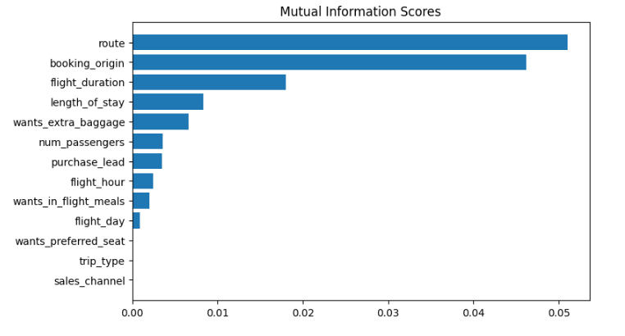
predictive model to understand factors that influence buying behaviour
We have trained the data set with XG-Boost classifier model on entire and received
ACCURACY: 0.845
AUC score: 0.77
route
booking_origin
flight_duration
wants_extra_baggage
length_of_stay
are the top 5 features which influence
Customer buying behavior based on
Mutual Information scores

Slide 3
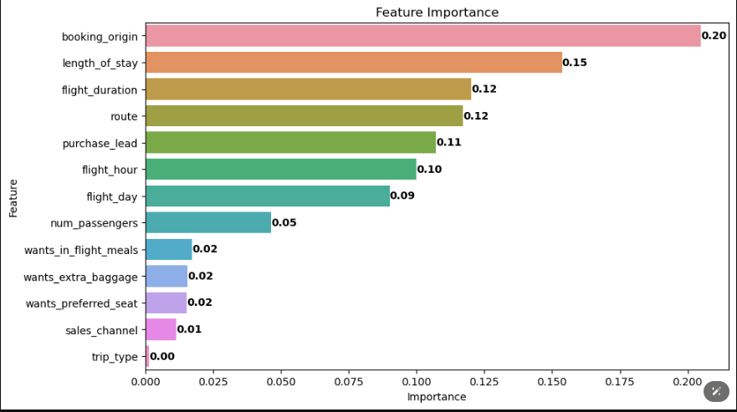
predictive model to understand factors that influence buying behaviour
We then re-trained the model based on feature importance which includes seven column and we had:
ACCURACY: 0.91
AUC score: 0.93
Route
Booking_origin
Flight_duration
Flight_hour
Length_of_stay
Flight_day
Purchase_lead
are the top six important features which
helps to better predict
Customer buying behavior

